Slide 1
Building Multi-language Power BI Reports in 2023
Ted Pattison
Principal Program Manager
Power BI Customer Advisory Team (PBICAT)

Slide 2
Agenda
Building Multi-language Reports in Power BI
Understanding How Translations Builder Works
Understanding the Localized Labels Table
Enabling Human Workflows for Translation using Export & Import
Implementing a Data Translations Strategy

Slide 3
Building Multi-language Reports in Power BI
Power BI provides Internationalization and localization features
You can design report that render in English, Spanish, French and German
It's no longer necessary to copy/maintain a separate PBIX file per language
Building multi-language reports will decrease maintenance and overhead
Recent Power BI Enhancements for Building Multi-language Reports
USERCULTURE function supported and used to create measures with dynamic translations
More properties of report visuals and shapes can be dynamically configured with measures
Introduction of Field Parameters offers much better options to implement data translations
There’s a tool to do more of the grunt work behind the scenes
Translations Builder 2.0

Slide 4
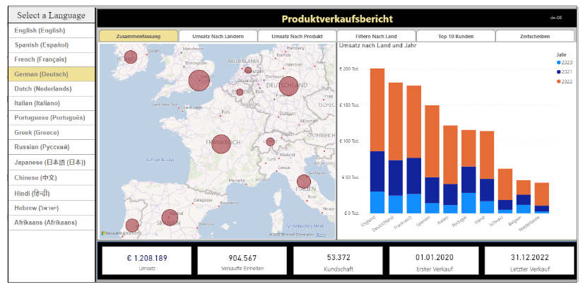
Multi-language Report Live Demo
https://multilanguagereportdemo.azurewebsites.net

Slide 5
Metadata Translations
Metadata translations supported for the localization of dataset object properties
Dataset object types supporting localization include Table, Column, Measure and Hierarchy
Dataset object translation properties include Caption, Description and DisplayFolder
Report labels can be localized with metadata translations using innovative approach
Metadata translations cannot be used to localize row-based content (e.g. product names)
Metadata translations currently require Power BI Premium – not supported in shared capacity
Metadata translations can also be used to localize report labels
Requires adoption of the localized label strategy
Report Layout does not support localization
Dataset Definition
supports localization
Metadata translations stored inside context of dataset definition
PBIX File (ProductSales.pbix)

Slide 6
Implementing Dynamic Translations with USERCULTURE
Xxx

Slide 7
Formatting Dates and Numbers with Current User Locale
en-US
es-ES
fr-FR
de-DE

Slide 8
Fundamental Types of Translations
Metadata translations (always required)
Translations for dataset object names including tables, columns and measures
Report label translations (always required)
Translations for literal string values used in report
Text strings used for report titles, section headings, button captions, etc.
Data Translations (sometimes required)
Translations of string values in the rows of data being analyzed

Slide 9
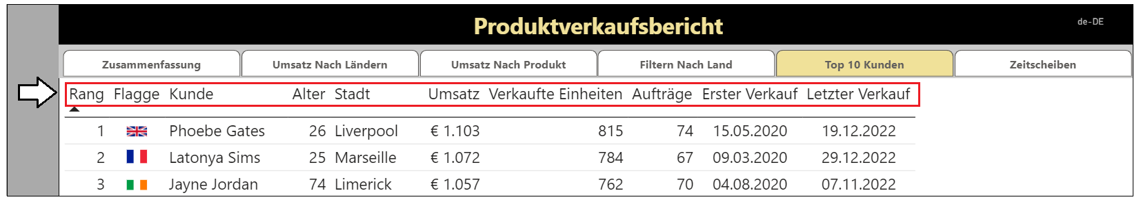
Metadata Translations

Slide 10
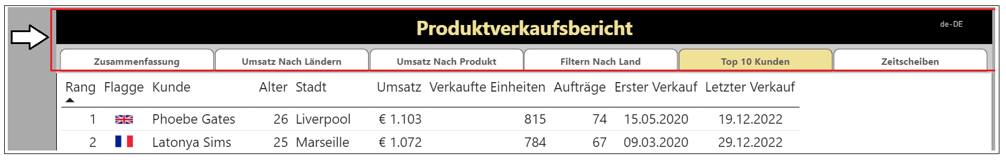
Report Label Translations

Slide 11
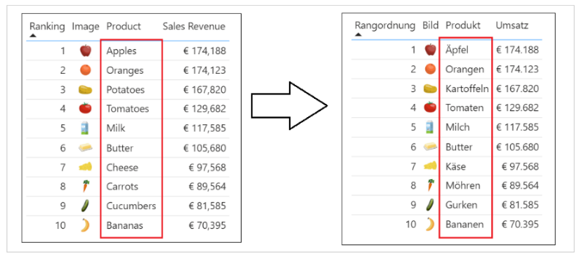
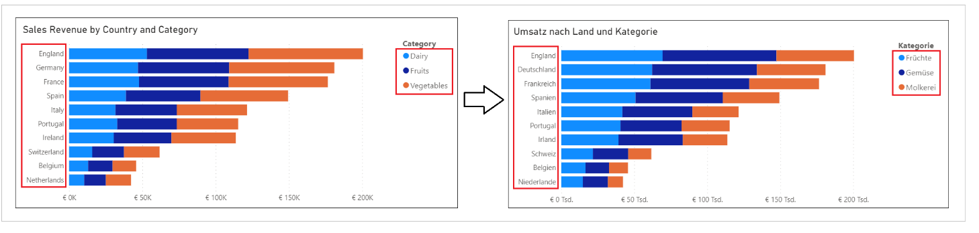
Data Translations

Slide 12
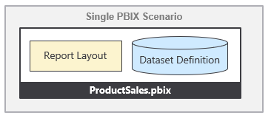
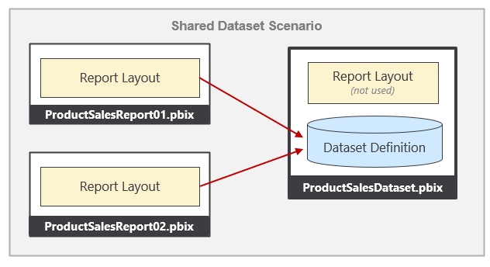
Packaging Dataset and Report in PBIX Project Files

Slide 13
Agenda
Building Multi-language Reports in Power BI
Understanding How Translations Builder Works
Understanding the Localized Labels Table
Enabling Human Workflows for Translation using Export & Import
Implementing a Data Translations Strategy

Slide 14
Agenda
Building Multi-language Reports in Power BI
Understanding How Translations Builder Works
Understanding the Localized Labels Table
Enabling Human Workflows for Translation using Export & Import
Implementing a Data Translations Strategy

Slide 15
Agenda
Building Multi-language Reports in Power BI
Understanding How Translations Builder Works
Understanding the Localized Labels Table
Enabling Human Workflows for Translation using Export & Import
Implementing a Data Translations Strategy

Slide 16
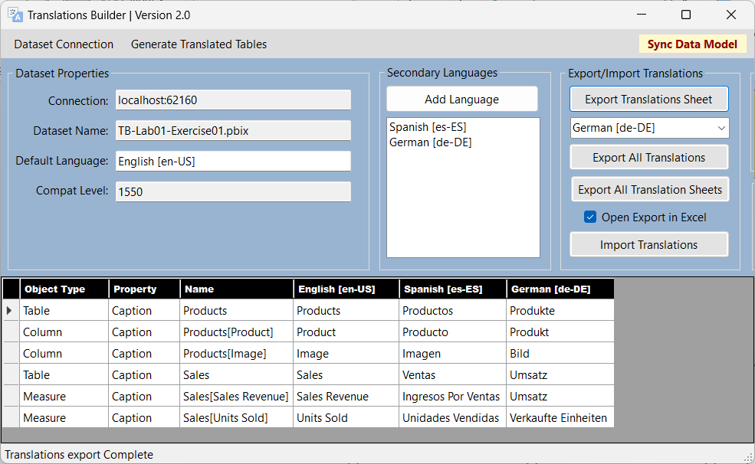
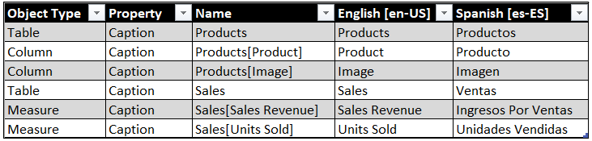
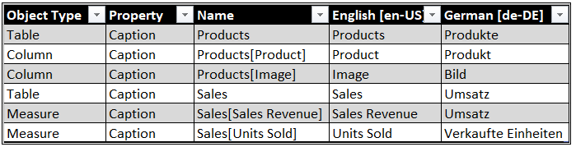
Human Workflow
Outbox
Project1-Translations-Spanish.csv
Export Translation Sheet
Project1-Translations-German.csv
Export Translation Sheet

Slide 17

Human Workflow
Outbox
Project1-Translations-Spanish.csv
Export Translation Sheet
Project1-Translations-German.csv
Export Translation Sheet
Inbox
Import Translation Sheet
Project1-Translations-Spanish.csv
Import Translation Sheet
Project1-Translations-German.csv

Slide 18
Enterprise Level Management
PBIX Project 1
Master
Translation
Sheet
PBIX Project 2
Export Operation
Import Operation

Slide 19
Enterprise Level Management
New PBIX
Project 1
Enterprise Master
Translation Sheet
Import Operation
Import Operation
New PBIX
Project 2
Import Operation
New PBIX
Project 3

Slide 20
Agenda
Building Multi-language Reports in Power BI
Understanding How Translations Builder Works
Understanding the Localized Labels Table
Enabling Human Workflows for Translation using Export & Import
Implementing a Data Translations Strategy

Slide 21
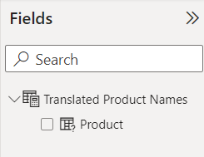
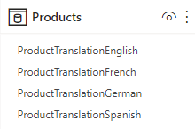
Field Parameters
column
selector

Slide 22
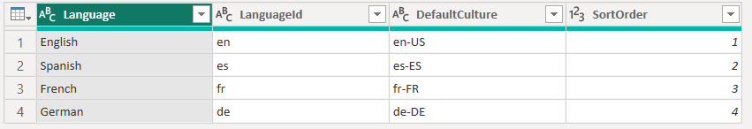
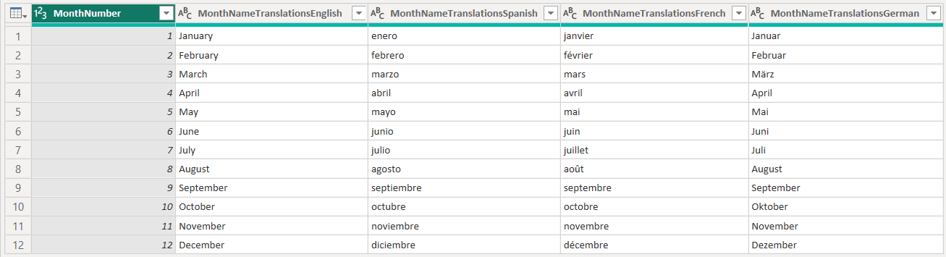
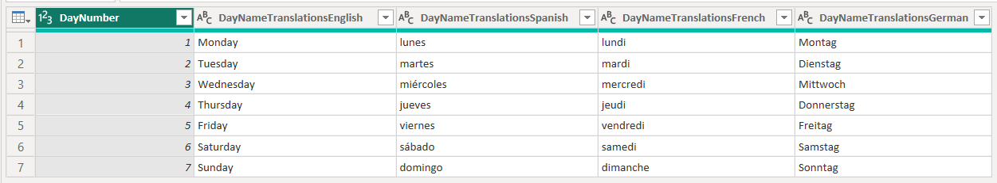
Languages
Power Query Transforms
Translated Month Names Table
Translated Day Names Table

Slide 23
Summary
Building Multi-language Reports in Power BI
Understanding How Translations Builder Works
Understanding the Localized Labels Table
Enabling Human Workflows for Translation using Export & Import
Implementing a Data Translations Strategy

